Slide 1
ERRORS IN PYTHON

Slide 2
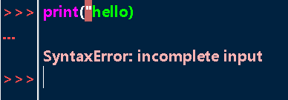
SYNTAX ERROR
Occurs when language rules are violated.
Eg
Quotation not closed.
Parenthesis not closed.
Colon missing.

Slide 3
RUN TIME ERROR

Slide 4
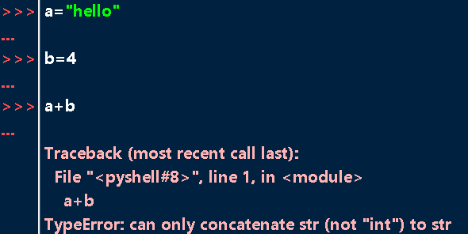
TYPE ERROR
Occurs when an inappropriate operation is performed on an object.
Common causes:
Unsupported operation between two objects
Calling a non callable object (calling a variable)
Incorrect type of list index(not giving index in int datatype)
Iterating a non iteratable
Passing wrong type of args to a function

Slide 5
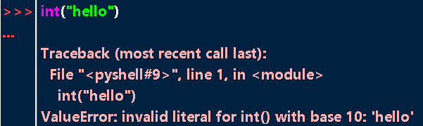
VALUE ERROR
Raised when invalid value is assigned to a variable or passed to a function.
Common causes
Invalid arg ( int(“hello”) )
Unpacking an iterable object (if less or more variables are used)

Slide 6
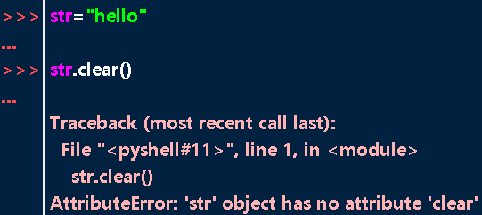
ATTRIBUTE ERROR
When we use wrong methods with an object.

Slide 7
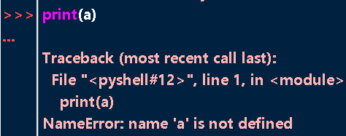
NAME ERROR
Occurs when undefined variable is used (includes class name, func name)

Slide 8
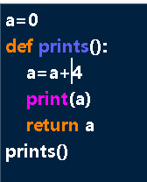
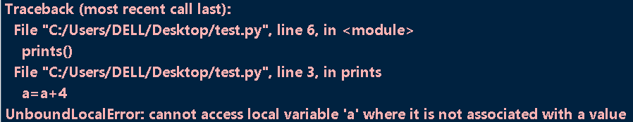
UNBOUND LOCALERROR
Raised when global variable is attempted to modified in local scope.
global keyword is used in such case.

